Slide 1


Day 24
Math24 (Differential Equations)
Ch 3.8 Forced Vibrations (Page 207-221)
Elementary Differential Equations and Boundary Value Problems, 10th edition, by William E. Boyce and Richard C. DiPrima, ©2013 by John Wiley & Sons, Inc.

Slide 2

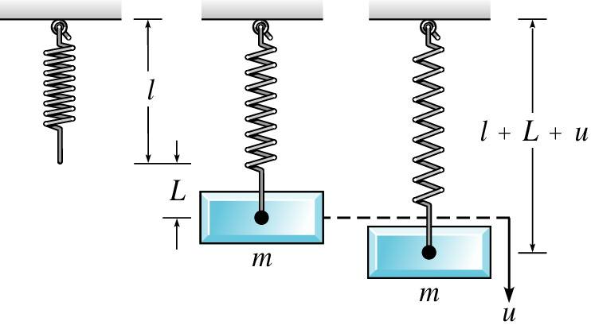
We continue the discussion of the last section, and now consider the presence of a periodic external force:

Slide 3



Forced Vibrations with Damping
Consider the equation below for damped motion and external forcing funcion F₀cosωt.
The general solution of this equation has the form
where the general solution of the homogeneous equation is
and the particular solution of the nonhomogeneous equation is

Slide 4
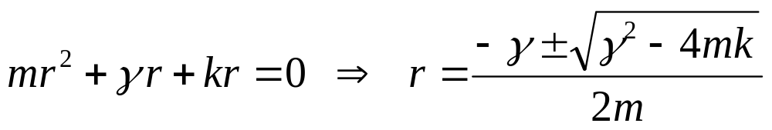
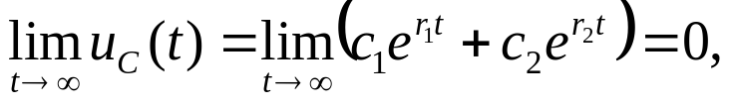
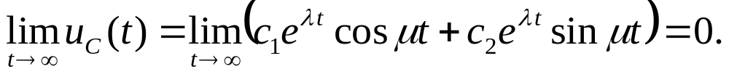
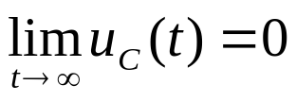
Homogeneous Solution
The homogeneous solutions u₁ and u₂ depend on the roots r₁ and r₂ of the characteristic equation:
Since m, γ, and k are are all positive constants, it follows that r₁ and r₂ are either real and negative, or complex conjugates with negative real part. In the first case,
while in the second case
Thus in either case,

Slide 5
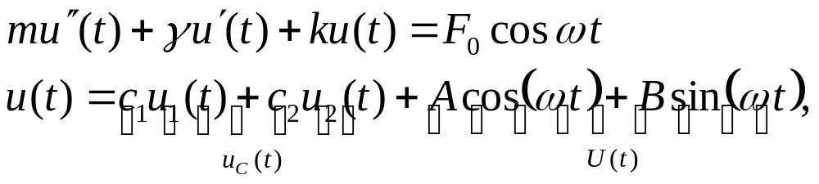
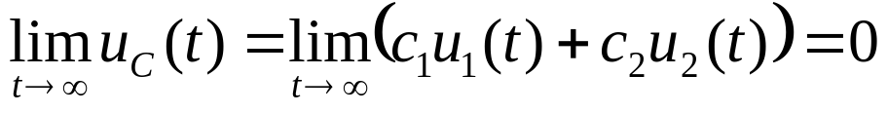
Transient and Steady-State Solutions
Thus for the following equation and its general solution,
we have
Thus u_{C}(t) is called the transient solution. Note however that
is a steady oscillation with same frequency as forcing function.
For this reason, U(t) is called the steady-state solution, or forced response.

Slide 6
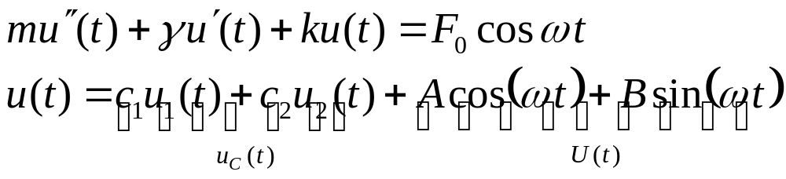
Transient Solution and Initial Conditions
For the following equation and its general solution,
the transient solution u_{C}(t) enables us to satisfy whatever initial conditions might be imposed.
With increasing time, the energy put into system by initial displacement and velocity is dissipated through damping force. The motion then becomes the response U(t) of the system to the external force F₀cosωt.
Without damping, the effect of the initial conditions would persist for all time.

Slide 7
Example 1 (1 of 2)
Consider a spring-mass system satisfying the differential equation and initial condition
Begin by finding the solution to the homogeneous equation
The methods of Chapter 3.3 yield the solution
A particular solution to the nonhomogeneous equation will have the form U(t) = A cos t + B sin t and substitution gives A = 12/17 and B = 48/17. So

Slide 8
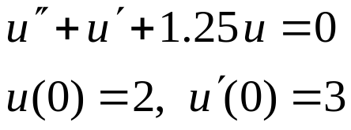
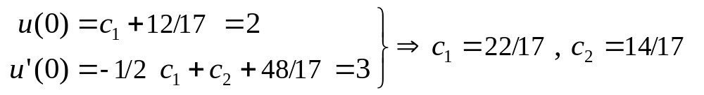
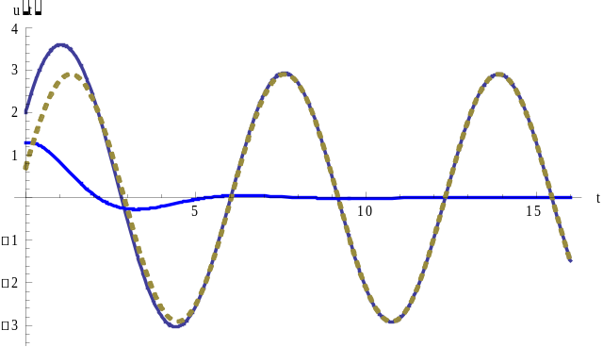




Example 1 (2 of 2)
The general solution for the nonhomogeneous equation is
Applying the initial conditions yields
Therefore, the solution to the IVP is
The graph breaks the solution
into its steady state (U(t))
and transient ( )
components

Slide 9

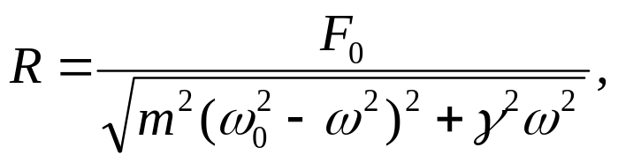
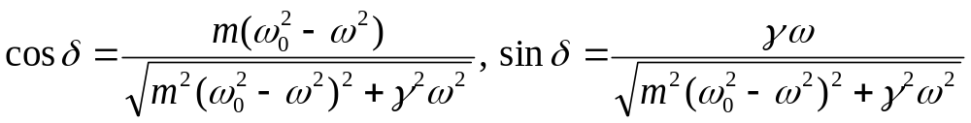
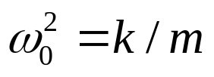
Rewriting Forced Response
Using trigonometric identities, it can be shown that
can be rewritten as
It can also be shown that
where

Slide 10
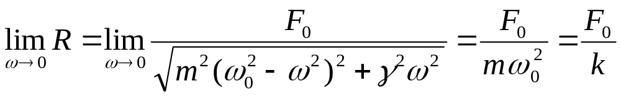
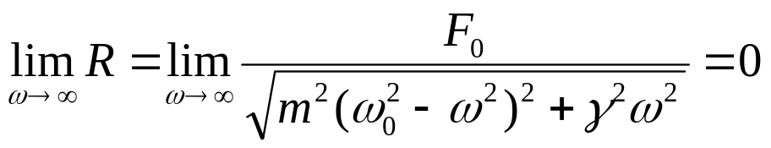
Amplitude Analysis of Forced Response
The amplitude R of the steady state solution
depends on the driving frequency ω. For low-frequency excitation we have
where we recall (ω₀)² = k /m. Note that F₀ /k is the static displacement of the spring produced by force F₀.
For high frequency excitation,

Slide 11
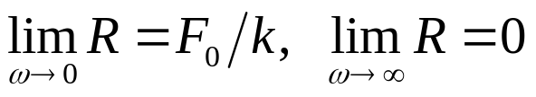
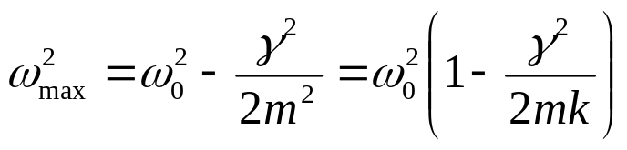
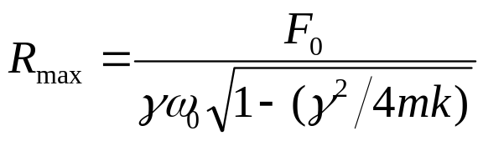
Maximum Amplitude of Forced Response
Thus
At an intermediate value of ω, the amplitude R may have a maximum value. To find this frequency ω, differentiate R and set the result equal to zero. Solving for ω_{max}, we obtain
where (ω₀)² = k /m. Note ω_{max} < ω₀, and ω_{max} is close to ω₀ for small γ. The maximum value of R is

Slide 12
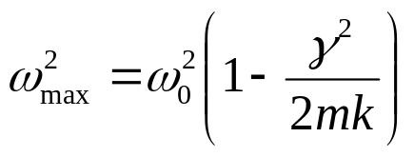
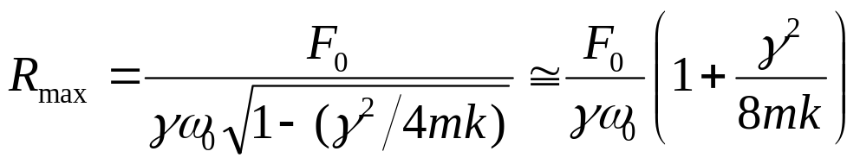
Maximum Amplitude for Imaginary ω_{max}
We have
and
where the last expression is an approximation for small γ. If
γ ² /(mk) > 2, then ω_{max} is imaginary. In this case, R_{max}= F₀ /k, which occurs at ω = 0, and R is a monotone decreasing function of ω. Recall from Section 3.8 that critical damping occurs when γ ² /(mk) = 4.

Slide 13
Resonance
From the expression
we see that R_{max}≅ F₀ /(γ ω₀) for small γ.
Thus for lightly damped systems, the amplitude R of the forced response is large for ω near ω₀, since ω_{max} ≅ ω₀ for small γ.
This is true even for relatively small external forces, and the smaller the γ the greater the effect.
This phenomena is known as resonance. Resonance can be either good or bad, depending on circumstances; for example, when building bridges or designing seismographs.

Slide 14
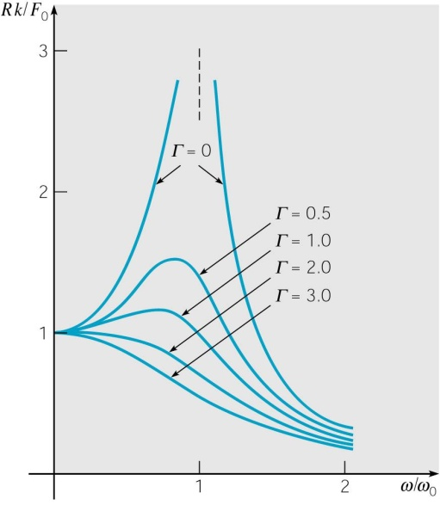
Graphical Analysis of Quantities
To get a better understanding of the quantities we have been examining, we graph the ratios R/(F₀/k) vs. ω/ω₀ for several values of Γ = γ ² /(mk), as shown below.
Note that the peaks tend to get higher as damping decreases.
As damping decreases to zero, the values of R/(F₀/k) become asymptotic to ω = ω₀. Also, if γ ² /(mk) > 2, then R_{max}= F₀ /k,
which occurs at ω = 0.

Slide 15
Analysis of Phase Angle
Recall that the phase angle δ given in the forced response
is characterized by the equations
If ω ≅ 0, then cosδ ≅ 1, sinδ ≅ 0, and hence δ ≅ 0. Thus the response is nearly in phase with the excitation.
If ω = ω₀, then cosδ = 0, sinδ = 1, and hence δ ≅ π /2. Thus response lags behind excitation by nearly π /2 radians.
If ω large, then cosδ ≅ -1, sinδ = 0, and hence δ ≅ π . Thus response lags behind excitation by nearly π radians, and hence they are nearly out of phase with each other.

Slide 16
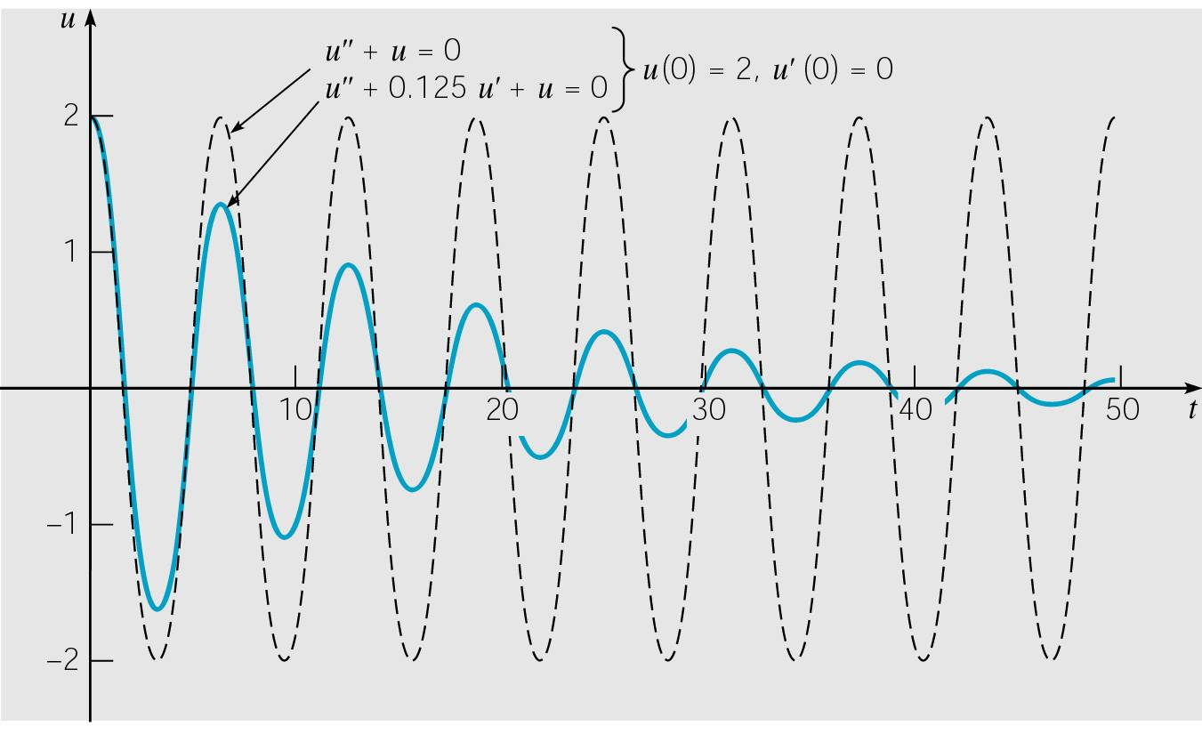
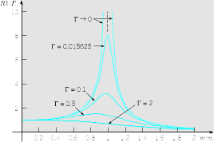
Example 2:
Forced Vibrations with Damping (1 of 4)
Consider the initial value problem
Then ω₀ = 1, F₀ = 3, and Γ = γ ² /(mk) = 1/64 = 0.015625.
The unforced motion of this system was discussed in Ch 3.7, with the graph of the solution given below, along with the graph of the ratios R/(F₀/k) vs. ω/ω₀ for different values of Γ.

Slide 17
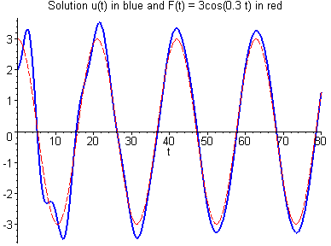
Example 2:
Forced Vibrations with Damping (2 of 4)
Recall that ω₀ = 1, F₀ = 3, and Γ = γ ² /(mk) = 1/64 = 0.015625.
The solution for the low frequency case ω = 0.3 is graphed below, along with the forcing function.
After the transient response is substantially damped out, the steady-state response is essentially in phase with excitation, and response amplitude is larger than static displacement.
Specifically, R ≅ 3.2939 > F₀/k = 3, and δ ≅ 0.041185.

Slide 18
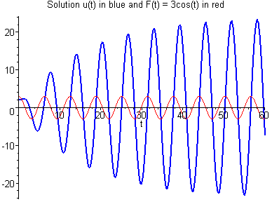
Example 2:
Forced Vibrations with Damping (3 of 4)
Recall that ω₀ = 1, F₀ = 3, and Γ = γ ² /(mk) = 1/64 = 0.015625.
The solution for the resonant case ω = 1 is graphed below, along with the forcing function.
The steady-state response amplitude is eight times the static displacement, and the response lags excitation by π /2 radians, as predicted. Specifically, R = 24 > F₀/k = 3, and δ = π /2.

Slide 19
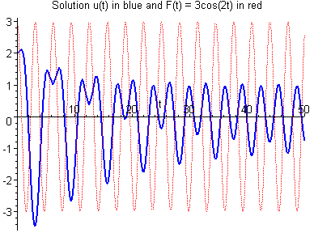
Example 2:
Forced Vibrations with Damping (4 of 4)
Recall that ω₀ = 1, F₀ = 3, and Γ = γ ² /(mk) = 1/64 = 0.015625.
The solution for the relatively high frequency case ω = 2 is graphed below, along with the forcing function.
The steady-state response is out of phase with excitation, and response amplitude is about one third the static displacement.
Specifically, R ≅ 0.99655 ≅ F₀/k = 3, and δ ≅ 3.0585 ≅ π.

Slide 20

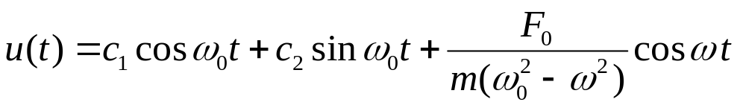
Undamped Equation:
General Solution for the Case ω₀ ≠ ω
Suppose there is no damping term. Then our equation is
Assuming ω₀ ≠ ω, then the method of undetermined coefficients can be use to show that the general solution is

Slide 21
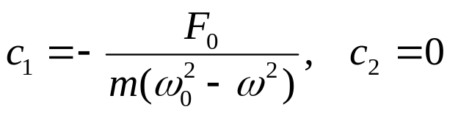
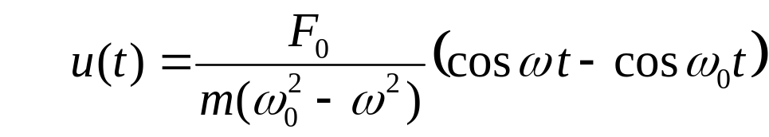
Undamped Equation:
Mass Initially at Rest (1 of 3)
If the mass is initially at rest, then the corresponding initial value problem is
Recall that the general solution to the differential equation is
Using the initial conditions to solve for c₁ and c₂, we obtain
Hence

Slide 22
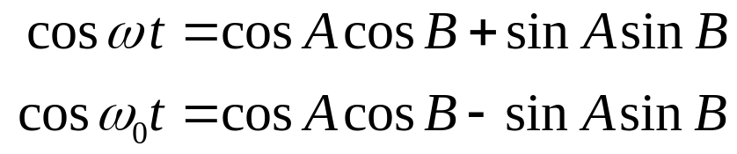

Undamped Equation:
Solution to Initial Value Problem (2 of 3)
Thus our solution is
To simplify the solution even further, let A = (ω₀ + ω)/2 and B = (ω₀ - ω)/2. Then A + B = ω₀t and A - B = ωt. Using the trigonometric identity
it follows that
and hence

Slide 23
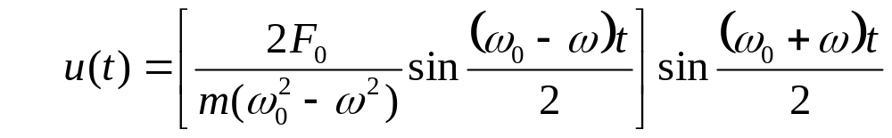
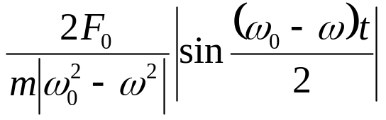
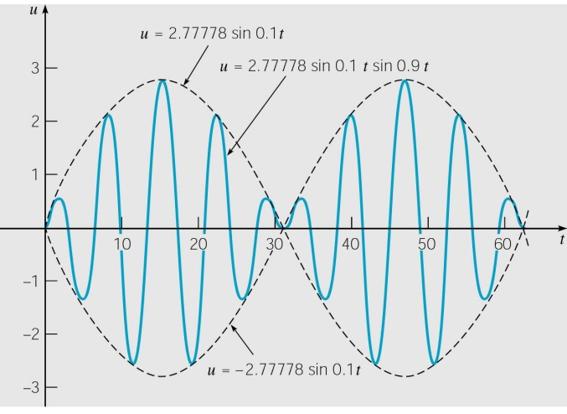
Undamped Equation: Beats (3 of 3)
Using the results of the previous slide, it follows that
When |ω₀ - ω| ≅ 0, ω₀ + ω is much larger than ω₀ - ω, and
sin[(ω₀ + ω)t/2] oscillates more rapidly than sin[(ω₀ - ω)t/2].
Thus motion is a rapid oscillation with frequency (ω₀ + ω)/2, but with slowly varying sinusoidal amplitude given by
This phenomena is called a beat.
Beats occur with two tuning forks of
nearly equal frequency.

Slide 24

Example 3: Undamped Equation,
Mass Initially at Rest (1 of 2)
Consider the initial value problem
Then ω₀ = 1, ω = 0.8, and F₀ = 0.5, and hence the solution is
The displacement of the spring–mass system oscillates with a
frequency of 0.9, slightly less than natural frequency ω₀ = 1.
The amplitude variation has a slow
frequency of 0.1 and period of 20π.
A half-period of 10π corresponds to
a single cycle of increasing and then
decreasing amplitude.

Slide 25
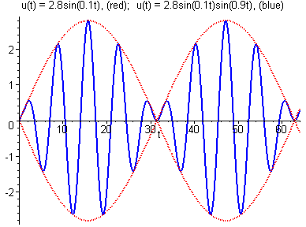
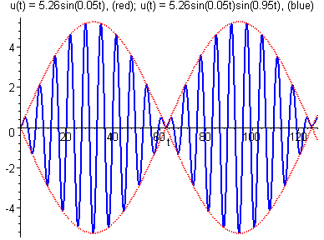
Example 3: Increased Frequency (2 of 2)
Recall our initial value problem
If driving frequency ω is increased to ω = 0.9, then the slow frequency is halved to 0.05 with half-period doubled to 20π.
The multiplier 2.77778 is increased to 5.2632, and the fast frequency only marginally increased, to 0.095.

Slide 26
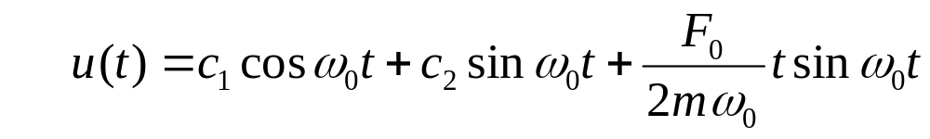
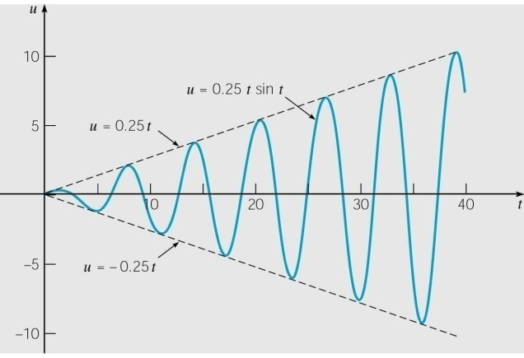
Undamped Equation:
General Solution for the Case ω₀ = ω (1 of 2)
Recall our equation for the undamped case:
If forcing frequency equals natural frequency of system, i.e., ω = ω₀ , then nonhomogeneous term F₀cosωt is a solution of homogeneous equation. It can then be shown that
Thus solution u becomes unbounded as t → ∞.
Note: Model invalid when u gets
large, since we assume small
oscillations u.

Slide 27
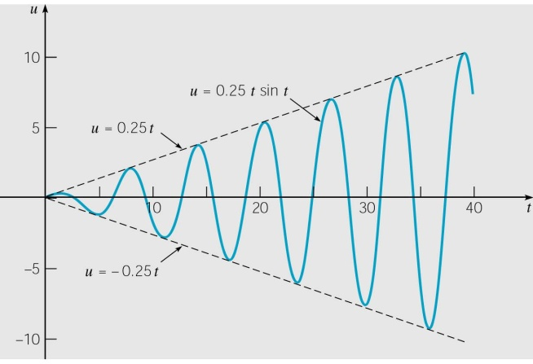
Undamped Equation: Resonance (2 of 2)
If forcing frequency equals natural frequency of system, i.e., ω = ω₀ , then our solution is
Motion u remains bounded if damping present. However, response u to input F₀cosωt may be large if damping is small and |ω₀ - ω| ≅ 0, in which case we have resonance.

Slide 28



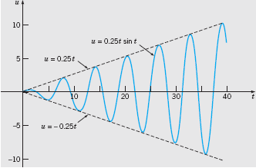
Example 4
Solve the initial value problem
And plot the graph of the solution.
The general solution of the differential equation is
And the initial conditions require that . Thus the solution of the given initial value problem is

